Slide 1
Extracting speech style from Movie frames
動画から抽出するスピーチスタイル
<2019 Frontier of artificial inteligence II>
37-176854
Kim hweemyoung（キム・フィミョン）

Slide 2
introduction
EXTRACTING SPEECH STYLE FROM MOVIE FRAMEs
Several speech synthesis models based on NN have been proposed.
Control on non-linguistic features(e.g. voice, styles) of synthesized speech is of huge interest among researchers.
Predicting such non-linguistic features referencing several format of data(e.g. audio, text) has been reported.
There is no news of trial on using visual data for prediction.
Realize speech synthesis system which facilitate movie frames to predict optimal and specialized expressive speech style

Slide 3
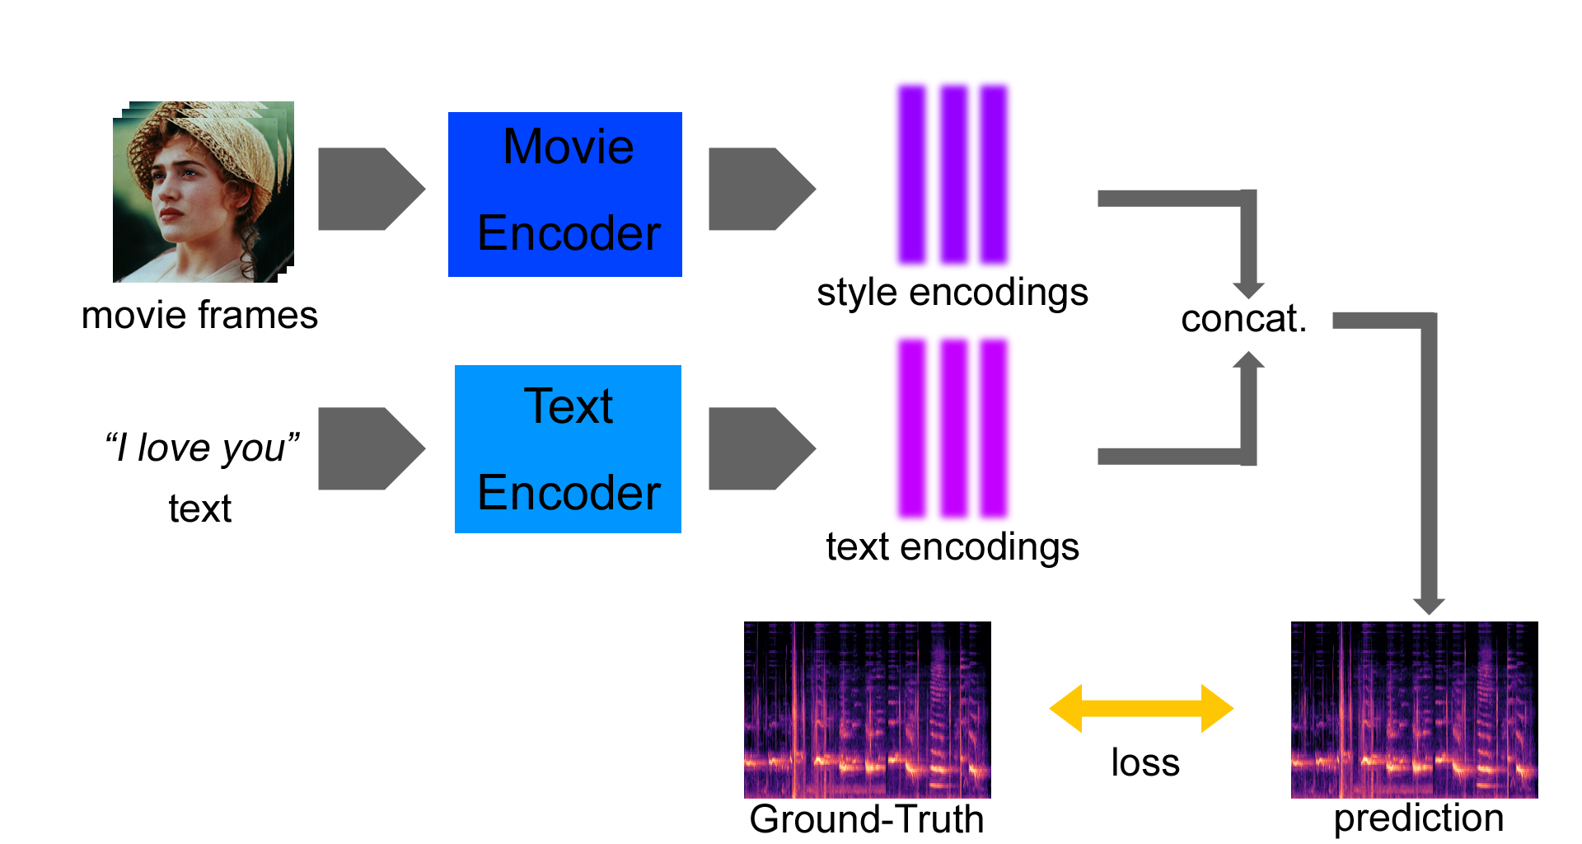
approach
EXTRACTING SPEECH STYLE FROM MOVIE FRAMEs
Methods
Learning mel spectrogram prediction parameters using Deep Neural Network
Dataset
Make use of pair data (movie frames, audio) of movies
Worth noticing
Frames: where to focus? (Body of speaker, or should include objects around speaker too?)
Audio: filter noises at which phase? (preprocessing or post-training?)
Model: should extract speech style only. Extraction of other features should be supressed.
Style tokens(GOOGLE Inc.) method seems very effective tackling these task.
(https://ai.googleblog.com/2018/03/expressive-speech-synthesis-with.html)
Fig: Model Architecture

Slide 4
procedure
BODY-EXPRESSION DRIVEN SPEECH SYNTHESIS
Training
1. Encoder
Input1: Training animation frames > body-expression embedding sequence(*)
Input2: Ground-Truth text > Script embedding sequence(**)
Hidden representation: Concatenate (*) and (**). (***)
2. Decoder: predict spectrogram. Decode (***) (with attention) in autoregressive manner.(****)
3. Calculate loss between (****) and spectrogram of Ground-Truth audio. Backpropagate and update params.
Evaluation
1. Encoder
Input1: Test animation frames > body-expression embedding sequence(*)
Input2: Target text > Script embedding sequence(**)
Hidden representation: Concatenate (*) and (**). (***)
2. Decoder: predict spectrogram. Decode (***) (with attention) in autoregressive manner.(****)
3. Vocoder: convert (****) to waveform using pretrained vocoder.
4. Evaluate: evaluate waveform with subjective(e.g. Mean Opinion Score) or objective(MCD, FFE, ...) methods.

